Slide 1
The Discussion Section
Fish 290
Tuesday May 7th

Slide 2
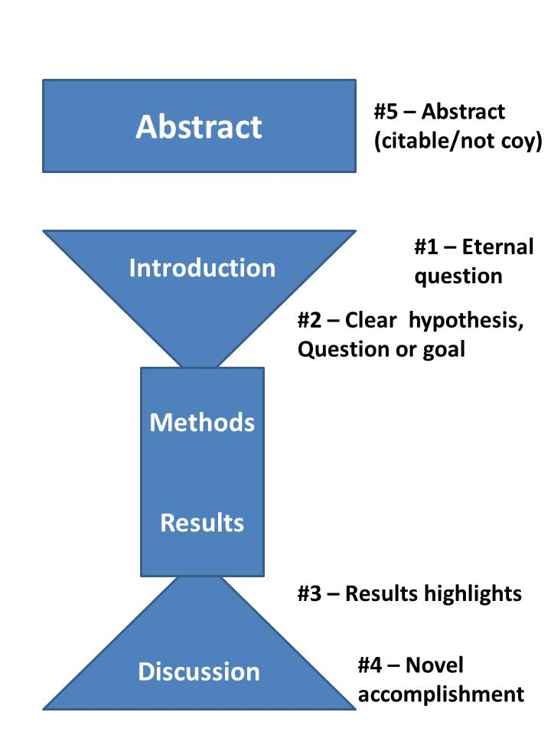
Recall paper structure and the 5 pivotal paragraphs
https://dynamicecology.wordpress.com/2016/02/24/the-5-pivotal-paragraphs-in-a-paper/
We are here

Slide 3
The Discussion section
“Your Discussion’s function is to turn data into knowledge.”
–Stephen Heard
You have just done the science, now what does it mean?

Slide 4
The Discussion section
First, interpret the data with respect to the specific objectives of the study.
Then, get progressively broader, bringing in related papers by others, and end with the concepts used to start the Introduction.
Use plain language: keep statistics in the Results

Slide 5
The Discussion section
You have more freedom in the Discussion section than other sections of your paper.
Whether that freedom scares you or excites you, you should always include the following elements!
I’ve included questions to think about to guide you in writing this section.

Slide 6
The Discussion section
Any Discussion section should have these elements, though the order is somewhat flexible:
The basic answer to the question you asked in the Introduction – this is the easy part
Detailed interpretation of key results
Consideration of limitations (include citations)
Relationship between your results and previous literature (include citations)
Broader implications of your results (include citations)
Future directions

Slide 7
The Discussion section
A basic template for a Discussion section:
Paragraph 1: Answer the question (a pivotal paragraph!)
Remind us what your question was and the key results.
Give us the basic answer to this question: what do your results mean, in simple language?
Keep this paragraph short

Slide 8
The Discussion section
A basic template for a Discussion section:
Paragraph 1: Answer the question (a pivotal paragraph!)
Questions to ask to help you write this paragraph:
What was your question?
What were your hypotheses?
How did you test these hypotheses (in plain language)?
Which hypothesis was supported?
What does this imply biologically (one-sentence simple version)?

Slide 9
The Discussion section
A basic template for a Discussion section:
Paragraph 2 or more: Detailed interpretation of each key result
(the # of paragraphs depends on how many key results you have or types of analyses you did)
Give each key result its own paragraph to interpret in detail
Relate this result to prior literature. Discuss how this result adds to our knowledge, and how it agrees/disagrees with past literature
May be a good place to consider alternative interpretations or limitations of this result

Slide 10
The Discussion section
A basic template for a Discussion section:
Paragraph 2 or more: Detailed interpretation of each key result
Questions to ask to help you write each paragraph:
What does this result mean biologically (can be more detailed)?
Are there multiple possible explanations for this result? What are they? Which is more plausible?
What about this result is most noteworthy or exciting? What it surprising or expected?
How does this result agree with past studies?
How does this result differ with past studies? What are the possible reasons for the difference?
Are there any reasons this result should be viewed with caution? Even still, what is valid about this result?
Do you think this result will apply to other organisms or environments? If so, why? Be specific.

Slide 11
The Discussion section
A basic template for a Discussion section:
Paragraph 3: Address limitations
One option is to set aside an entire paragraph for limitations or contrarian arguments
This should never be the last paragraph of the Discussion. Otherwise, the last impression readers will have about your work will be negative

Slide 12
The Discussion section
A basic template for a Discussion section:
Paragraph 3: Address limitations
Must be done, but carefully*. No research is perfect, and failure to address possible concerns will only make the reader suspicious.
You want to acknowledge possible limitations without casting doubt on the entire study. How do you do this?
*you have a reading on this subject in Canvas
Good advice here: https://dynamicecology.wordpress.com/2019/06/17/to-be-sure/

Slide 13
The Discussion section
A basic template for a Discussion section:
Paragraph 3: Address limitations
Addressing limitations
“Yes, but” strategy: “Although we found a significant result, the sample size for this study was limited. With a greater sample size we would be more confident in our result.”
The negative is in the stress position, last thing reader thinks about
Doesn’t explain how your results are still valid, so this is left to the reader’s (very critical) imagination
“But, yes” strategy: “Even with a limited sample size, we still detected a significant result. This suggests that we had enough power to detect a difference in means, if such a difference exists.”
The positive is in the stress position, last thing reader thinks about
Explains how your results are still valid, so reader can have a more balanced view of the evidence

Slide 14
The Discussion section
How to get started addressing your study’s limitations:
Ask yourself:
What are possible reasons my results could be biased or wrong?
If I showed my study to my friend/professor/labmate, what would they be skeptical about?
Then ask yourself (for example):
How likely are these biases, and under what conditions would they show up?
How would I know if they are affecting my data? What signs would there be?
Even if these biases were affecting my data, would I still expect a similar result?
Even if this method (or these data, etc.) can’t address X, can it still address Y?
Even if I’m using a proxy for some variable, can it still reveal a similar pattern?
Is there a future line of work that can fill any gaps that remain?
*you have a reading on this subject in Canvas
Good advice here: https://dynamicecology.wordpress.com/2019/06/17/to-be-sure/

Slide 15
The Discussion section
A basic template for a Discussion section:
Paragraph 4: Broader implications and future directions
(or more; # of paragraphs depends on how many implications you can think of)
Broader implications: the farthest reach your results may plausibly have for our understanding of the world
Go as broad as you started in the Introduction. If one section is broader than the other, you need to adjust one of them
Be honest about what we can say with your results (but don’t be too modest either)
Discuss areas of future research to stretch your results even further

Slide 16
The Discussion section
A basic template for a Discussion section:
Paragraph 4: Broader implications and future directions
Questions to ask to help you write these paragraphs:
What is the biggest problem or knowledge gap you can think of that your results help solve, and why? (Did you go too big? A smaller knowledge gap is legitimate too!)
What do we still need to know in order to understand how your results solve the big problem you identified?
How might we go about filling in the remaining gaps?

Slide 17
The Discussion section
Compare:
“More research is needed.”
Meaningless (more research is always needed)
Not specific: what should we do next?
Looks bad: minimizes the impact of your work
“Future studies might consider how the combination of temperature and pH work in concert to impact larval crab development.”
Ties into the big picture
Specific: gives a breadcrumb for other researchers to pick up, or even starts your next study!
Exciting: makes us look forward to future work!

Slide 18
The Discussion section
A basic template for a Discussion section:
Paragraph 5: Conclusion (a pivotal paragraph!)*
(or, the last paragraph of your discussion)
“In conclusion, we…” Remind us yet again of the take-home
Say how we are better off (knowledge gap filled, big problem solved)
Keep this paragraph short
Do not mention limitations here
*I think a conclusion paragraph is important for readers to remember the take-home. Other authors find them repetitive and don’t use them.

Slide 19
Assignments
Read “The Discussion Section” and “Dealing with Limitations” on Canvas.
Begin writing your Discussion section.
Continue working on your posters using PowerPoint
Poster session Thursday! Read all directions on Canvas.

